Slide 1
W2_D5 - ANN
Sivasankar Arul

Slide 2
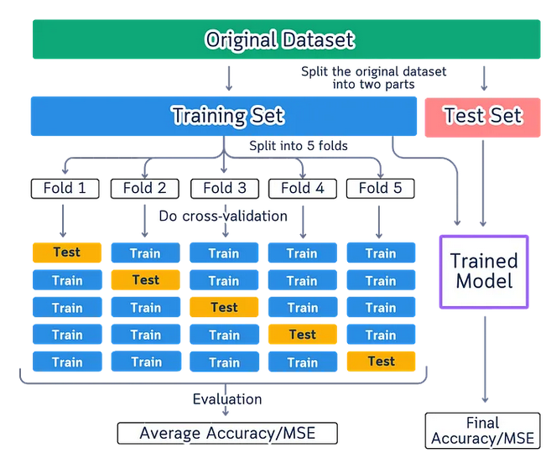
K fold

Slide 3
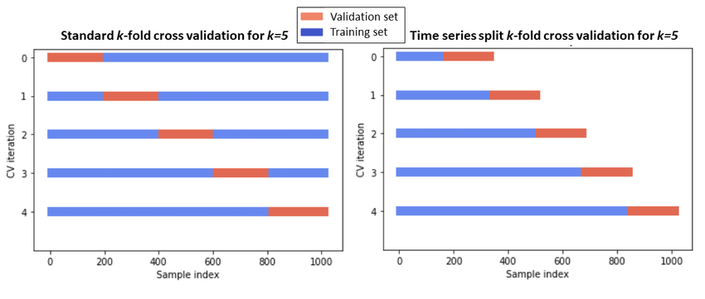
Tile series K fold

Slide 4
K fold
KFold cross-validation, the 'shuffle=True' parameter specifies that the data should be shuffled before splitting it into folds. This helps ensure that the data is randomly distributed in each fold, reducing the potential for bias or unrepresentative splits.
Key Points:
- Default Behavior: By default, shuffle=False, meaning the data is split in the order it is provided.
If the data is sorted or structured, this may lead to unrepresentative folds.
- Shuffling: Setting shuffle=True randomizes the order of the data before splitting it into folds,
ensuring an unbiased distribution.
- Random Seed: The random_state=42 ensures that the shuffling is reproducible.
Example:
Suppose you have a dataset sorted by class labels:
X = [1, 2, 3, 4, 5, 6, 7, 8, 9, 10] # Features
y = [0, 0, 0, 0, 1, 1, 1, 1, 2, 2] # Labels
- Without shuffling: Fold 1 = [1, 2], Fold 2 = [3, 4], ... Fold 5 = [9, 10].
- With shuffling: Fold 1 = [7, 3], Fold 2 = [2, 9], ... Fold 5 = [8, 4].
Each fold is more likely to represent the overall dataset distribution.
Why It Matters:
Shuffling is important when:
- The data has some inherent order (e.g., sorted by time, labels, or feature values).
- You want each fold to be representative of the overall data for better training and evaluation.

Slide 5
Stratified K fold - issues
Assumption of IID Data:
Stratified k-fold assumes data samples are Independent and Identically Distributed (IID):
Independent: Each sample is unrelated to others.
Identically distributed: Samples come from the same, consistent distribution.
Under this assumption, stratification ensures a representative dataset for evaluation and learning.
The Potential Issue
Not all datasets adhere to the IID assumption. Dependencies or distribution shifts may make stratified k-fold unsuitable. Examples include:
Temporal Dependencies: Data collected over time often exhibits patterns, making samples correlated. Example: Stock prices or weather data where today's values affect tomorrow's.
Spatial Dependencies: Geographic data may have correlations between adjacent regions. Example: Satellite imagery where neighboring areas share characteristics.
Distribution Shifts: Training and testing distributions may differ. Example: User behavior predictions where training data is from winter, and testing data is from summer.
Grouped or Clustered Data: Samples within a group may not be independent. Example: Medical data with multiple samples from the same patient.
In these cases, stratified k-fold can lead to data leakage or overestimated performance, as training and test samples may not be truly independent.
What to Do Instead
For datasets that violate the IID assumption, consider these alternatives:
Group k-Fold Cross-Validation: Ensures all samples from the same group (e.g., a patient, region, or time period) are in either the training or testing fold but not both.
Time Series Split: For time-dependent data, ensures training data precedes testing data chronologically.
Custom Splits: Tailor train-test splits to reflect dependencies or distribution changes in the data.
Domain-Specific Adjustments: Adapt the validation strategy using domain knowledge, e.g., splitting by geographic regions or experimental conditions.
Why It Matters
Using stratified k-fold without considering the data’s nature can result in:
Overestimation of performance: Dependency or leakage allows the model to "see" patterns in the test set.
Poor real-world generalization: A mismatched validation strategy may lead to model failure in deployment.

Slide 6
K-Fold vs Stratified K-Fold
For example, if you have a dataset with 80% Class A and 20% Class B:
K-Fold might result in folds with very different proportions, e.g., Fold 1 = 90% A, 10% B.
Stratified K-Fold will maintain 80% A and 20% B in every fold.

Slide 7
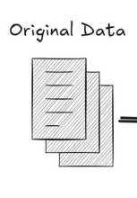
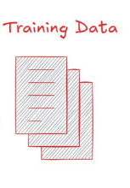
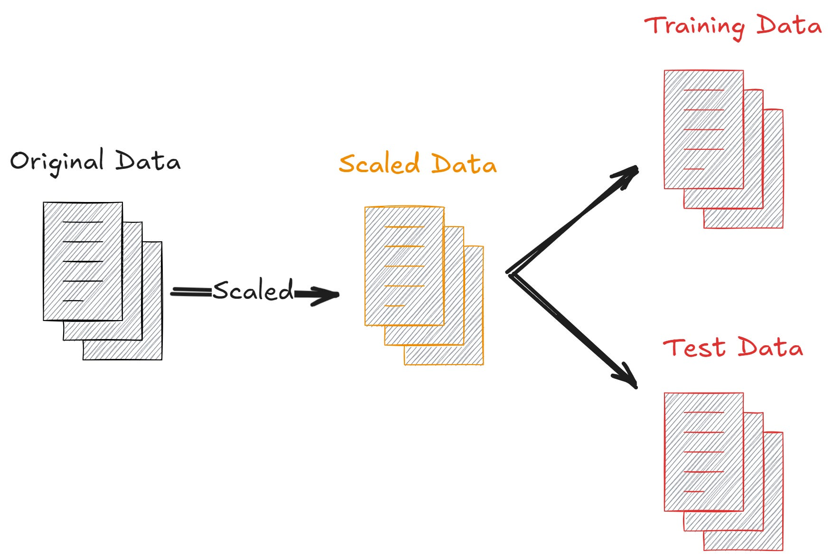
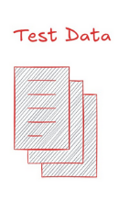
Data leakage - scaling
Scalar
Fit
Transform
Scaled
Scalar
Transform

Slide 8
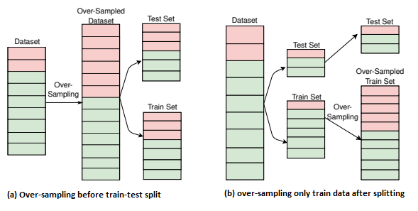
Data leakage - oversampling

Slide 9
Summary - CV
What is Cross-Validation?
A statistical method for estimating machine learning model performance.
Splits dataset into training and testing parts, repeating the process with multiple splits for a comprehensive evaluation.
Common Techniques:
K-Fold Cross-Validation: Divides data into ‘k’ folds; trains on ‘k-1’ folds and tests on 1. Repeats for each fold. Balances bias and variance.
Leave-One-Out (LOO): Uses a single data point for testing and the rest for training. Best for small datasets but computationally expensive.
Stratified K-Fold: Maintains class distribution in folds, ideal for imbalanced datasets.
Time-Series Split: Ensures training on past and testing on future data; essential for temporal datasets.
Advantages:
Reliable out-of-sample performance estimate.
Reduces overfitting risk.
Suitable for diverse data types (with the right technique).
Disadvantages:
Computationally intensive, especially for large datasets.
Specific methods required for time-series or imbalanced data.

Slide 10
Summary - CV
Best Practices:
Use pipelines to prevent data leakage (e.g., preprocessing steps fit only on training data).
Perform sensitivity analysis for choosing appropriate k in K-Fold.
For regression, use Stratified K-Fold with binned targets to maintain distribution.
Validate time-series models with TimeSeriesSplit to ensure temporal consistency.
Common Mistakes to Avoid:
Oversampling before cross-validation, leading to data overlap and overestimation.
Random splits in time-series data, disrupting temporal structure.
Feature engineering on the whole dataset before splitting (e.g., PCA).
Advanced Considerations:
For deep learning models, use multiple random seeds in cross-validation to account for variability in performance estimates.
Combine Group K-Fold with stratification for hierarchical or imbalanced datasets.

